Slide 1
Creation of a Database “Information system automation of restaurant work”
Suleimenova Inkara

Slide 2
Intoduction
In today's world, automation plays a key role in various business areas, including the restaurant segment. From optimizing processes to improving customer service, the introduction of modern information technologies is becoming an integral part of the success of enterprises in the catering industry. In this introduction, we will consider the importance of restaurant business automation, identify its main characteristics and justify the relevance of the chosen topic.
The topic of this course work is related to the automation of the restaurant business. The subject area covers all aspects of the restaurant's operation, from order management and analysis of purchase data. The software in question is designed to optimize the operation of restaurants of various types and scales.
The relevance of the research topic is due to the growing competition in the field of public catering and increased demands from consumers. In conditions of fast pace of life and changing customer preferences, restaurant enterprises are forced to look for ways to optimize processes, reduce service time and improve the quality of service.
Thus, this introduction makes it possible to understand the importance of automation of the restaurant business, substantiates the relevance of the research topic, and also defines the purpose and objectives of the course work.

Slide 3
Characteristics of the subject area
Last name and first name of the customer: Stores the names of customers who visit the restaurant.
Phone number: Records the contact numbers of customers and staff.
Reserved table: Indicates the tables that have been reserved by customers.
The day of the visit: Tracks the date on which customers visit the restaurant.
Last visit date: Stores the data of the customer's last visit.
Online ordering: Indicates whether the order was placed online.
Menu: Represents the menu items available in the restaurant.
Last name and first name of the staff: Records the names of staff members working in the restaurant.
Phone number: Stores the contact numbers of staff.
Job Title: Represents the position or job title of staff members.
Payment method: Represents the different methods of payment available.
Order: Represents the details of orders placed by customers.

Slide 4
Data volume and structure
Customer table
Data volume: The customer table is expected to store information about each customer of the restaurant. The amount of data depends on the number of customers who visit the restaurant.
Data structure: Includes the attributes customer_id, first_name, last_name, phone, book_date, visit_day and last_visit_date.
Order Table
The amount of data: Depends on the number of orders placed in the restaurant.
Data structure: Includes order ID, customer ID, staff ID, beverage ID, dish ID, invoice ID and payment ID.
Restaurant table
The amount of data: The restaurant table is expended to store information about the work of the restaurant. The amount of data depends on the menu, staff.

Slide 5
entity-relationship diagram
ER diagrams (entity-relationship) are a graphical representation of the database structure that displays entities (also known as tables), the attributes of these entities and the relationships between them. They are an important tool for database design, helping developers and analysts better understand the structure of data and the relationships between them.
ER diagrams help to visualize the data structure, which simplifies the process of designing and understanding a database, especially when working with more complex systems. They are also used for documentation and communication between development team members and stakeholders.

Slide 6
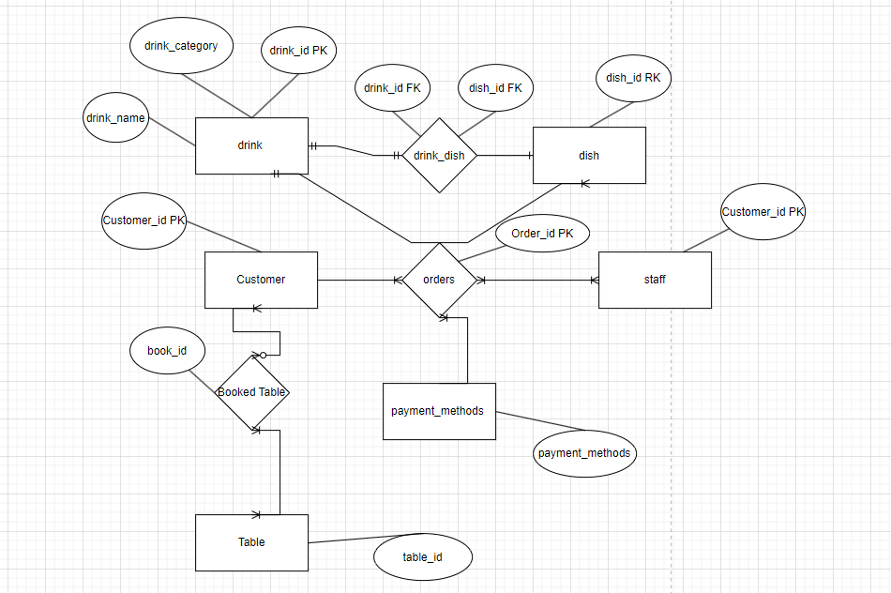
entity-relationship diagram

Slide 7
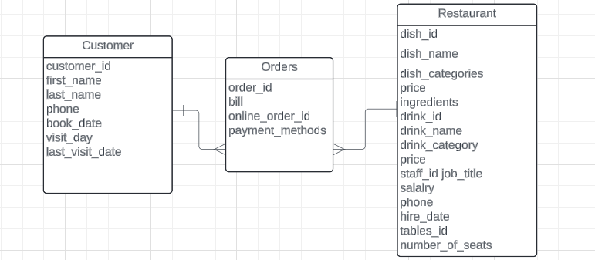
Reduction to normal forms
Description of a data structure in first normal form

Slide 8
Moving from the ER model to database schemas
The transition from an ER model (entity-relationship) to database schemas is the process of converting a conceptual data model, represented as an ER diagram, into a physical database structure, that is, a set of tables, relationships, and constraints that implement this model.

Slide 9
Moving from the ER model to database schemas
A total of 10 tables were received: customers, tables, reserved table, dish, drink, snack bar, staff, payment methods, orders and online orders. What can be done for this:
1. Open SQL Server Management Studio.
2. Click on the new query. Here we first create a database by attributing:
create database restaurant
3. After quickly creating the database, we start creating tables using the create table syntax table_name(data type column name, ...)

Slide 10
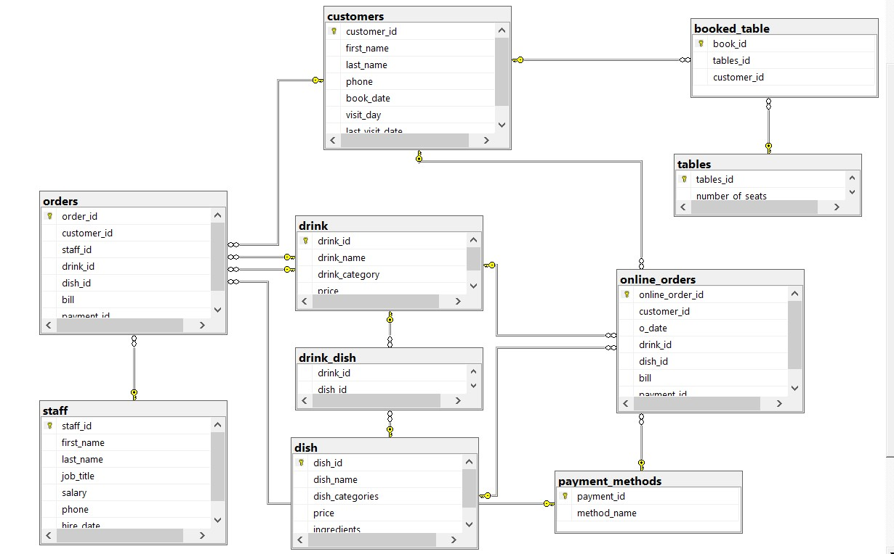
Database Scheme

Slide 11
Moving from the ER model to database schemas
At this stage, I have an error. Initially, when I created date strings, the datetime data type was char (10) NOT NULL CHECK (odate LIKE ‘_ _/_ _/_ _ _ _'). But then, when I tried to insert the data, a similar error occurred:

Slide 12
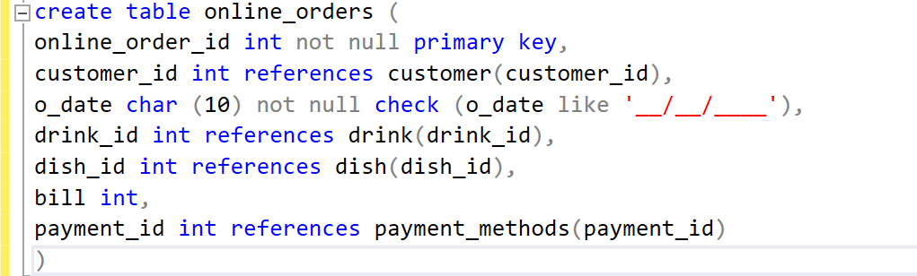
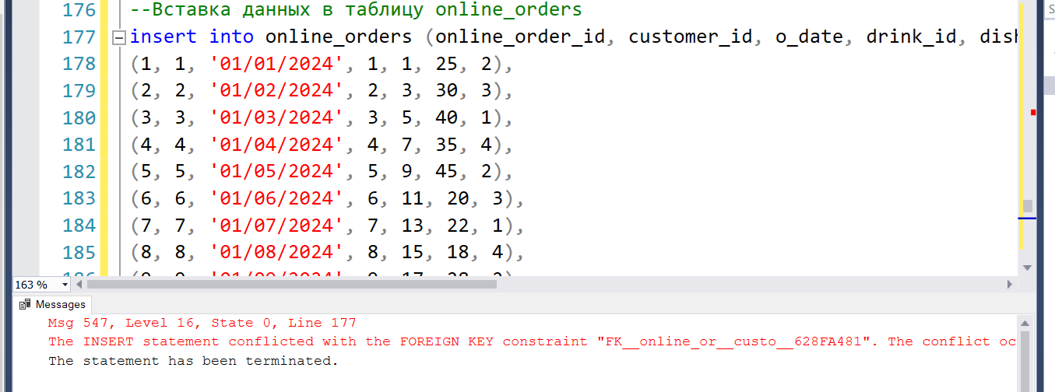
Moving from the ER model to database schemas

Slide 13
Creating view, indexes, triggers, procedures
I have created a view that combines information about orders from the orders and online_orders tables and that gives all the information about orders. Called her OrderDetails.

Slide 14
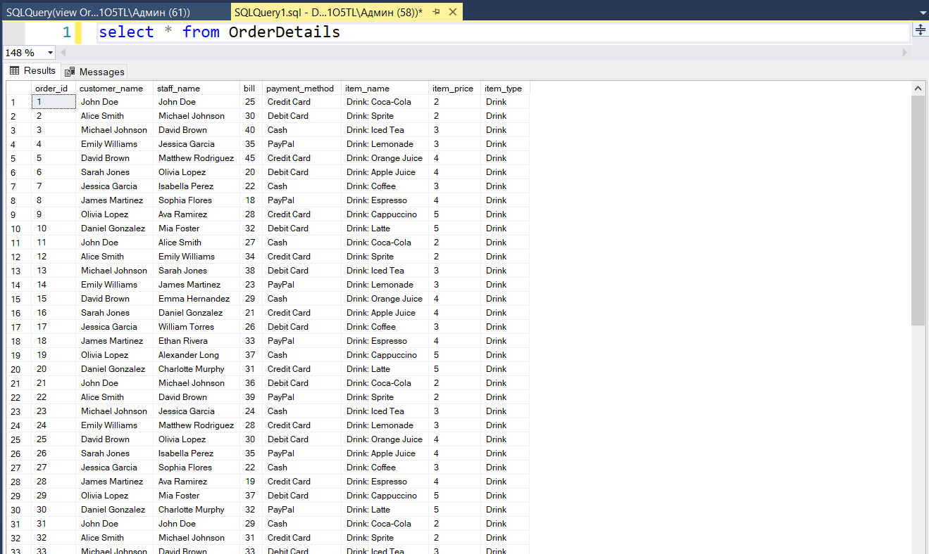
View

Slide 15
Index
The index of the customer_id field. This index will help speed up the operations of searching and filtering orders by customer ID.
create index idx_customer_id on online_orders (customer_id)
The index for the payment_id field. This index can help with transactions related to order payment methods.
create index idx_payment_id on online_orders (payment_id)
Each of these indexes will improve the performance of queries using the corresponding fields by quickly finding and filtering data.

Slide 16
Trigger
I have created a trigger for the orders table that will update the total amount of the order after each update

Slide 17
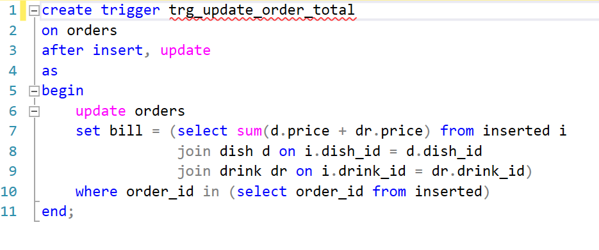
Trigger

Slide 18
Stored Procedure
The first stored procedure is the menu. I did it for two reasons. The first is to restrict access to data. I have restricted access to menu data only through certain access points, for example, through a stored procedure. This helps to manage security and prevent direct access to database tables.
And the second is performance improvement. In the case of large amounts of data or high load on the database server, performing server-side operations using stored procedures can lead to improved performance and efficiency of the application.

Slide 19
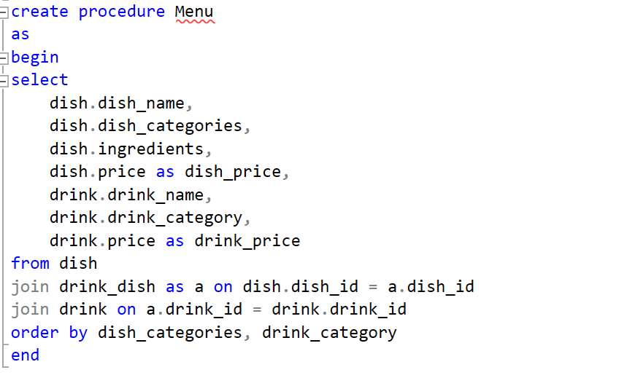
Stored Procedure Menu

Slide 20
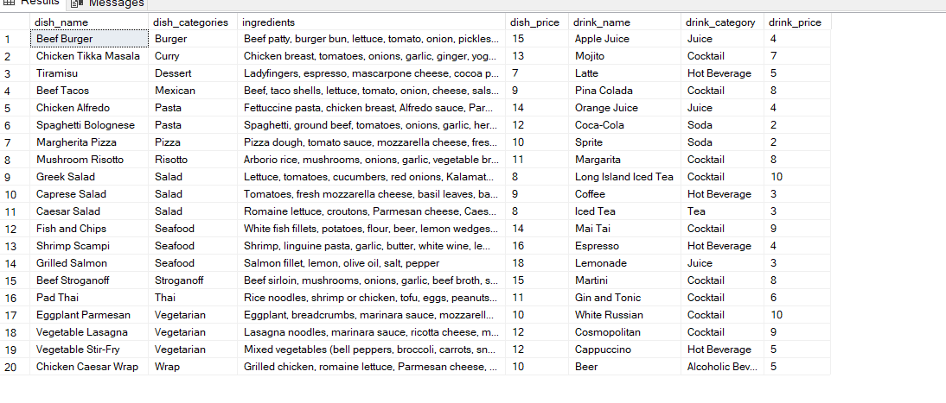
Stored Procedure Menu

Slide 21
Stored Procedure sales_analytics
The second stored procedure is the purchase analytics for Orders. I did it for three reasons. The first two are described above, and the last one is the frequency and volume of data. When my restaurant has a large number of transactions and purchase data is updated frequently, using a stored procedure can help ensure quick access to data and efficient execution of analytical queries.

Slide 22
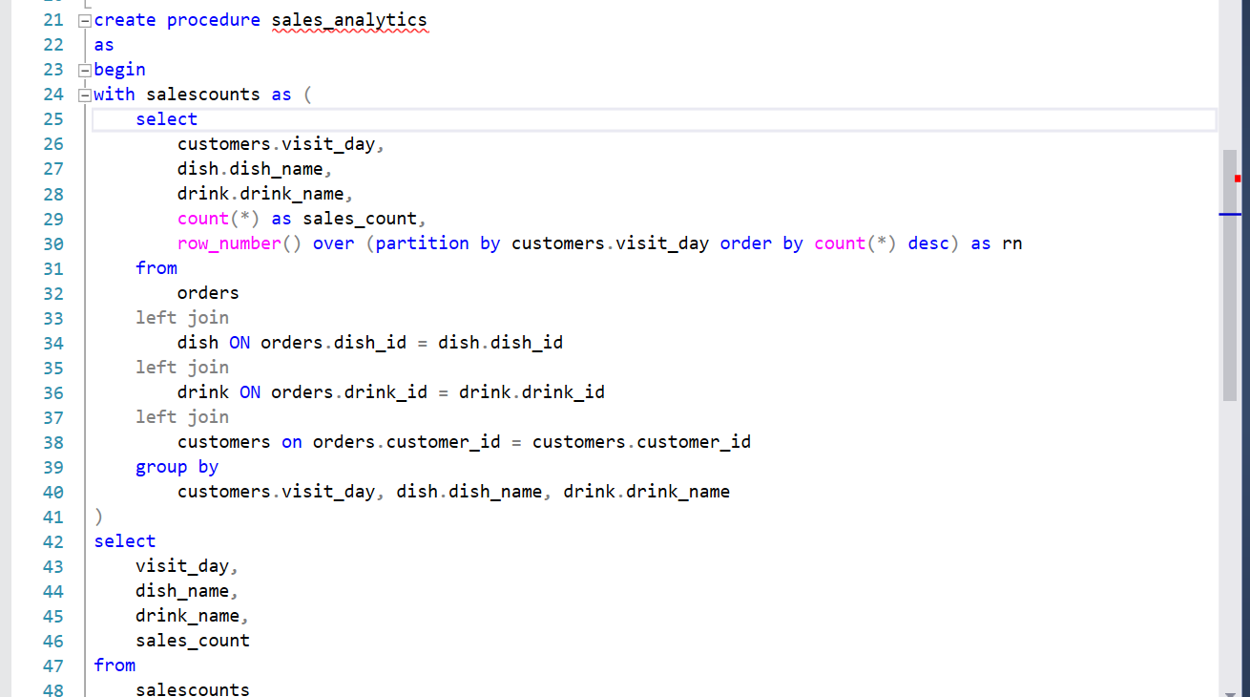
Stored Procedure sales_analytics

Slide 23
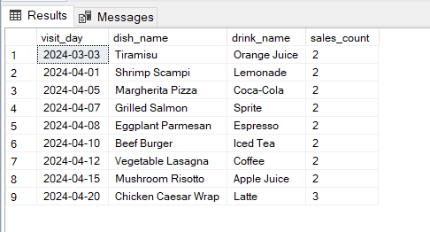
Stored Procedure sales_analytics

Slide 24
Stored Procedure sales_analytics_online
And the last stored procedure is the purchase analytics for Online Orders.

Slide 25
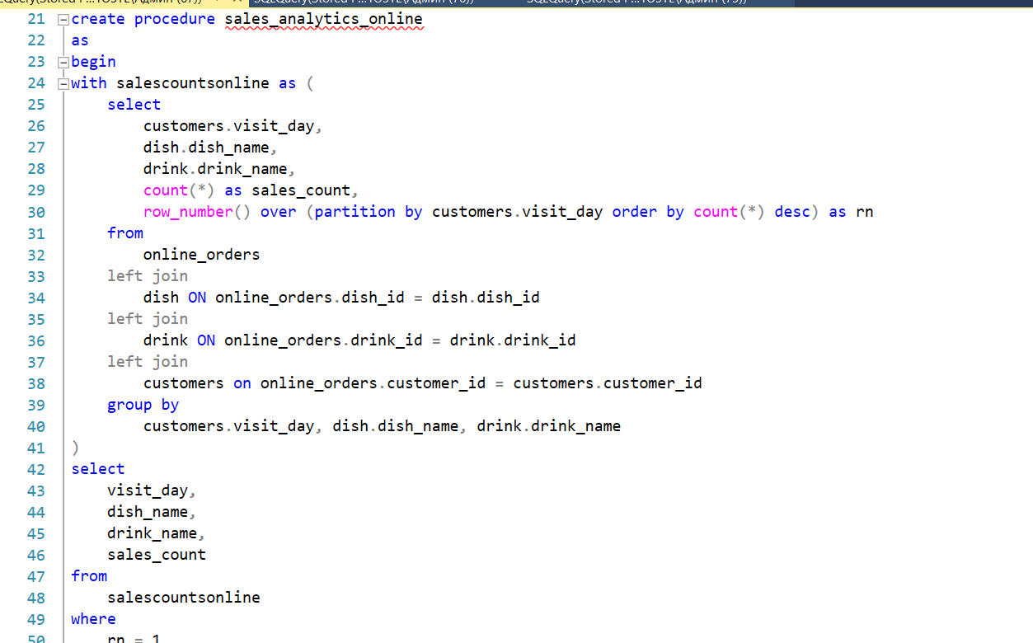
Stored Procedure sales_analytics_online

Slide 26
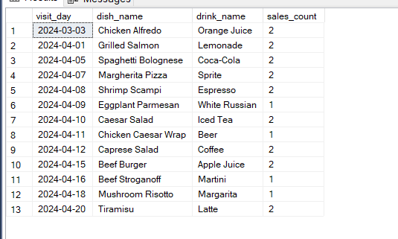
Stored Procedure sales_analytics_online

Slide 27
Conclusion
In conclusion, it is safe to say that the restaurant business is in a constant state of development and change. Nowadays, when technology plays a key role in everyday life, its introduction into the restaurant business is becoming a necessity, not just a fashion trend. Automating routine processes such as product accounting, order processing, and personnel management frees up valuable time for employees, allowing them to focus on more important tasks such as quality customer service.
Moreover, automation not only simplifies the life of the staff, but also increases the efficiency of the entire enterprise. Electronic warehouse and order management systems help reduce waiting and order processing time, which in turn improves the overall quality of service and customer satisfaction.
Finally, automation also helps to reduce operating costs and minimize the human factor in the maintenance process. This makes the restaurant business more resilient to changes in external conditions and more competitive in the market.
Thus, the introduction of technology and automation of routine in the restaurant business play a key role in ensuring its success and prosperity in the modern world.

Slide 28
Bibliography
Ramez Elmasri. Shamkant B. Navathe. FUNDAMENTALS OF Database Systems SEVENTH EDITION: book-2016-1239p
Barkov I.A. - Object-oriented programming: textbook - Lan Publishing House - 2019-- ISBN: 978-5-8114-3586-9 - Electronic text // EBS Lan - URL: https://e.lanbook.com/book/119661
Ivanova G.S. Programming technology: textbook / Ivanova G.S. — Moscow: KnoRus, 2018. — 333 p. — (for bachelors). — ISBN 978-5-406-06109-1. — URL: https://book.ru/book/926372 (date of access: 10/10/2019). — Text: electronic.
C.J. Date. SQL and Relational Theory: How to Write Accurate SQL Code: textbook – 2009 – 432p
Joshua M. Stiglitz. SQL Programming & Database Management For Noobs: textbook – 2016 – 194p
Sergey Skudaev. Learn SQL by Examples: Examples of SQL Queries and Stored Procedures for MySQL and Oracle: textbook – 2012 – ISBN: 1546996346

